Slide 1
OPENMP END TERM PROJECT
Group H

Slide 2
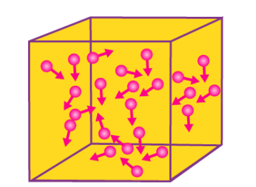
Project Title: Many Body Collisions
Team members
Jothi Prakash - 19EC30028
Rekha Lokesh - 19EC10052
Sampara Sai Charan - 19EC10057
Chaitanya Bhargav N - 19EC10016
Geddam Ashlesh Kumar - 19EC10080

Slide 3
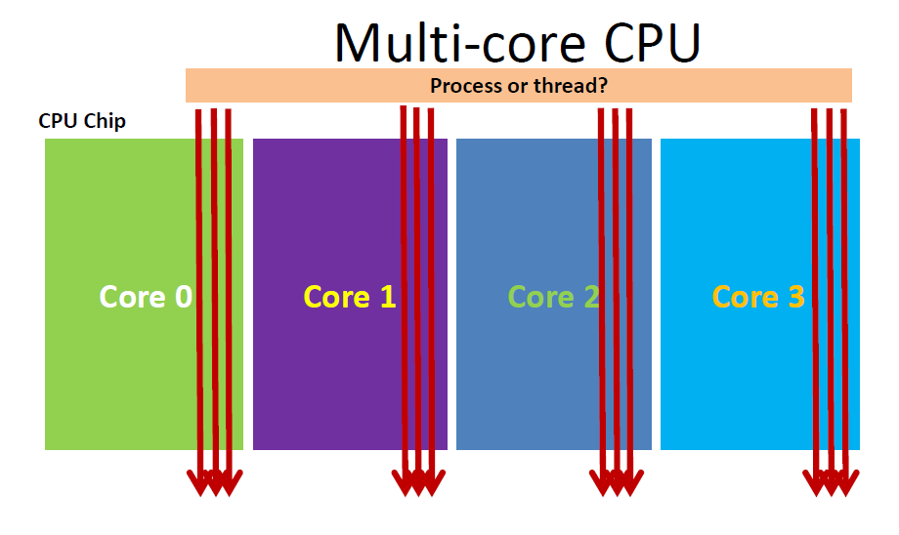
Open MP
OpenMp allows us to perform parallel execution of code on the machine using the predefined facilities that are defined in it. This allows us to use the full capability of modern systems to increase efficiency and throughput of the systems.

Slide 4
Multi Body Simulations
OPENMP - CPP Code

Slide 5
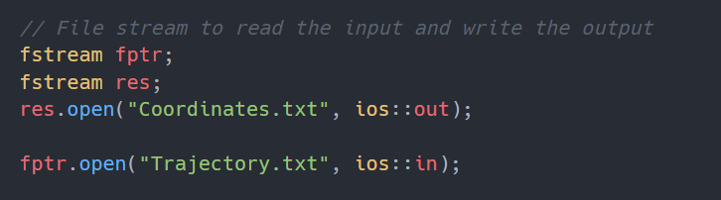
Reading And Writing To The Files
File Stream is used to read the input from the Trajectory.txt file.
File Stream is used to write the output to the Coordinates.txt file.

Slide 6
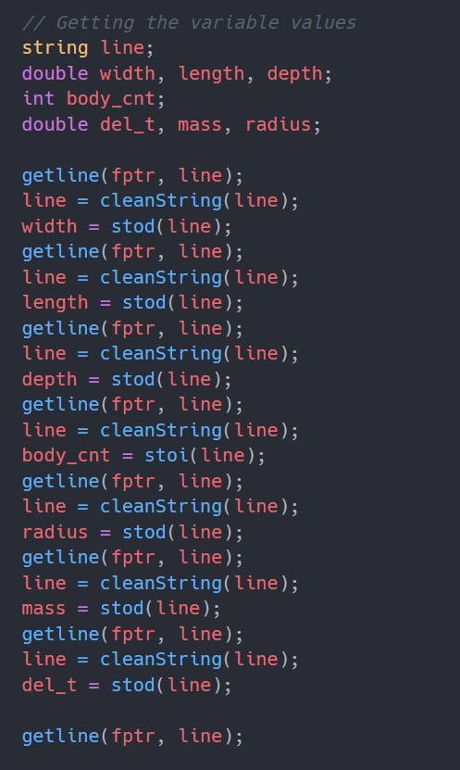
Storing The Input Values

Slide 7
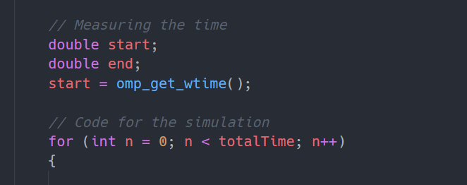
Simulation In Every Time Step

Slide 8
Simulation Step One
Firstly, we need to calculate the force acting on each particle using every other particle in the environment.
This is done by calculating the distance between them and applying the force formula, to derive the Vector force acting on them.
This part is highly independent and therefore can be parallelized completely.
To make it more efficient we can collapse the 2 loops for better efficiency.

Slide 9
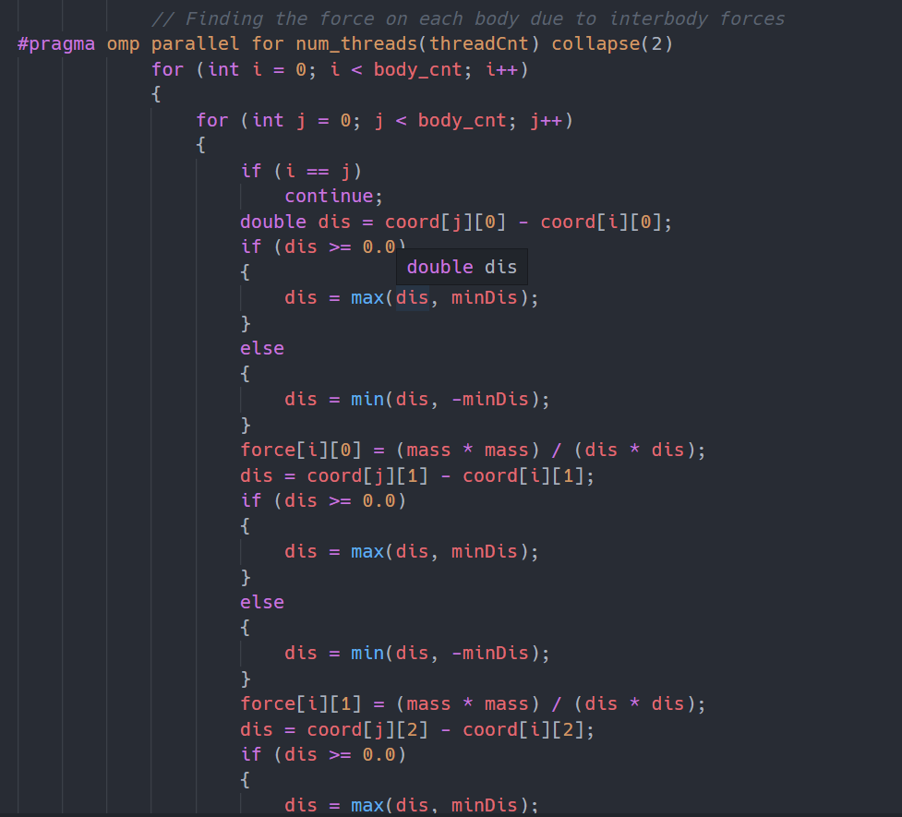

Slide 10
Simulation Step Two
After calculating the force, we need to calculate the change in velocity of each body due to the force acting on it.
This is done in 2 intermediate half steps, where we first update the velocity by half the required value. Then we calculate the coordinates. Then we again increase the velocity by another half the required value.
This region can also be parallized, as all the velocity and coordinate updates are independent of each other.

Slide 11
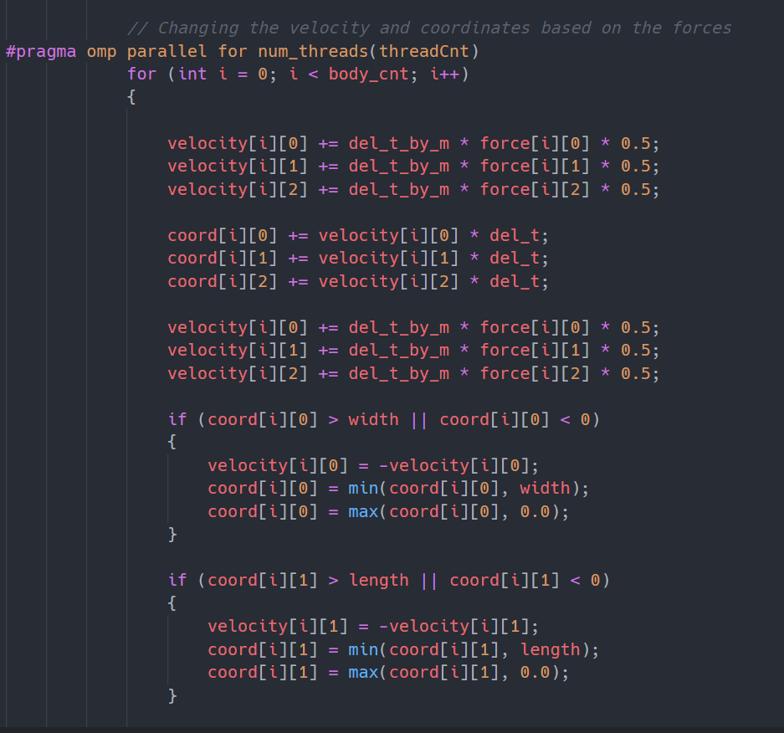

Slide 12
Simulation Step Three
Once we have updated the velocity and the coordinates, we need to check about the collision between the particles.
This can be done by measuring the distance between the 2 particles and applying Newton’s Law of Momentum Conservation as the collision is assumed to be perfectly elastic.
This region can also be parallelized as the velocity and the coordinates are already calculated.

Slide 13
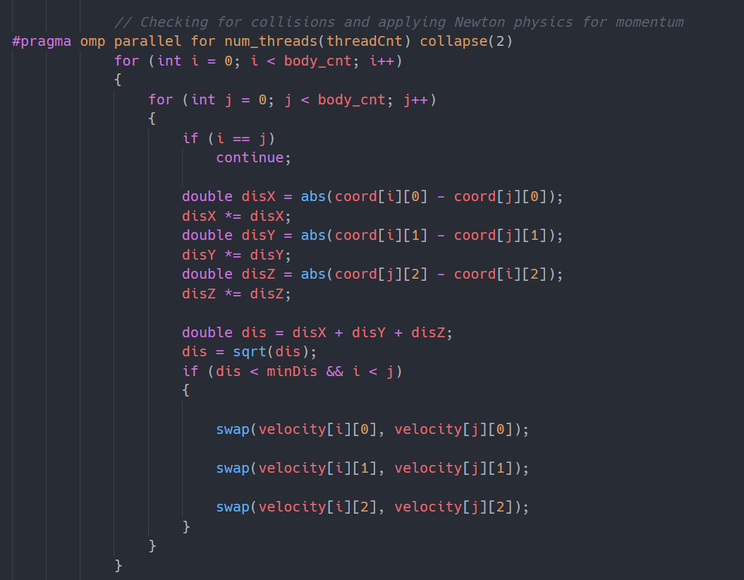

Slide 14
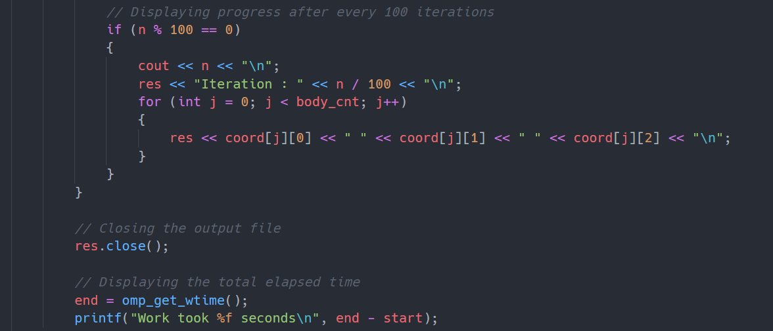
Finalizing The Results
After all the calculations, we store the coordinates of all the particles in a Coordinates.txt file after every 100 time step.
Finally we measure the amount of time taken to process everything and display the results, for comparison between different system specifications.

Slide 15
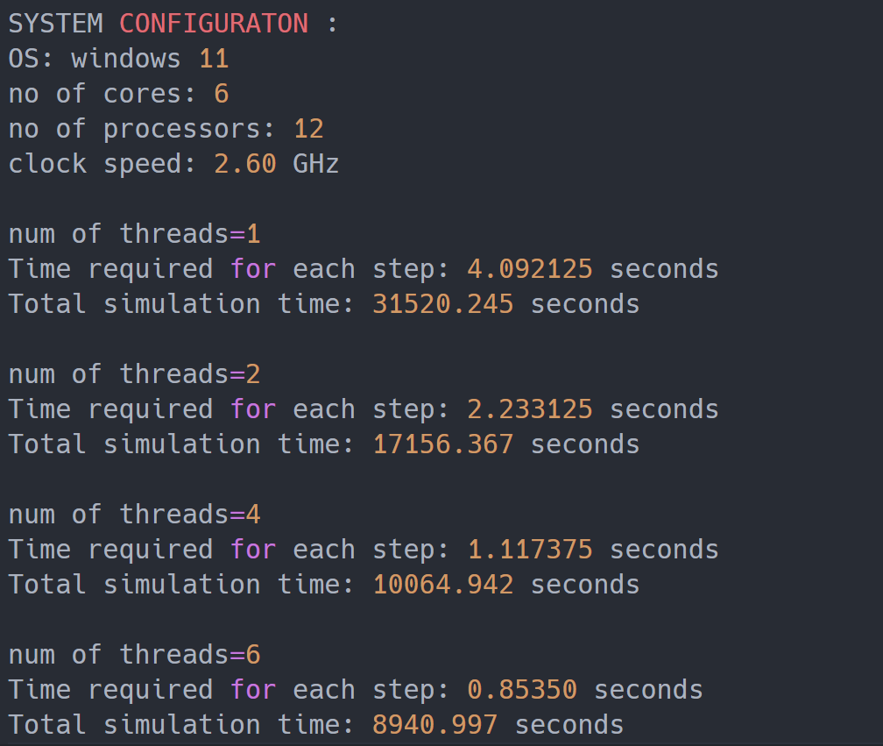
Results

Slide 16
Graphic Visualiser
Using MATLAB

Slide 17
Reading the data from txt file
close all;
clear all;
clc;
filepath = 'Coordinates.txt'; %Coordinates of body path
fileId = fopen(filepath, 'r'); %Opening the file
line = fgetl(fileId);
w = str2double(regexp(line, '[\d.]+', 'match')); %Width of the file
line = fgetl(fileId);
l = str2double(regexp(line, '[\d.]+', 'match')); %Length of the file
line = fgetl(fileId);
d = str2double(regexp(line, '[\d.]+', 'match')); %Depth of the file
line = fgetl(fileId);
N = str2double(regexp(line, '[\d.]+', 'match')); %Number of bodies
line = fgetl(fileId);
r = str2double(regexp(line, '[\d.]+', 'match')); %Radius of a body
line = fgetl(fileId);
t_step = str2double(regexp(line, '[\d.]+', 'match')); %Time Step
line = fgetl(fileId);
num_step = str2double(regexp(line, '[\d.]+', 'match')); %Number of time steps or iterations
data = zeros(3, N, num_step);
C = rand(N, 3); %Random Color for each ball
Opening the text file that has the coordinates of the particles
Reading individual lines from the text file and searching for numerical values in the line using regex expressions.
Using random number generator to randomize the colour of the particles in the plot.

Slide 18
Plotting the Many Bodies
figure("Name", "Many Body Graphics", 'units','normalized','outerposition',[0 0 1 1]);
for i = 1:num_step
clf; %clears the previous iteration plotted bodies of the figure
line = fgetl(fileId);
iter_num = str2double(regexp(line, '[\d.]+', 'match')); %Reads the Iteration number
coord = fscanf(fileId, '%f %f %f', [3, N*num_step]);%Reads all the Coordinates of the N bodies
scatter3(coord(1, :), coord(2, :), coord(3, :), r*70, C, 'filled'); %plotting all the n bodies
hold on;
grid on;
xlabel('x');
ylabel('y');
zlabel('z');
title(["Many Bodies Positions at iteration = ",num2str(i)], "Color", 'r');
axis([0, w, 0, l, 0, d]);
hold off;
currframe(i) = getframe; stores the current image frame
drawnow();
data(:, :, i) = coord; %Storing the data for every time step in one 3d matrix
disp("Iteration "+int2str(i)+" Data Loaded");
end
%plotting all the n bodies of the ith iteration
scatter3(coord(1, :), coord(2, :), coord(3, :), r*70, C, 'filled');
hold on;
grid on;
xlabel('x');
ylabel('y');
zlabel('z');
title(["Many Bodies Positions at iteration = ",num2str(i)], "Color", 'r');
axis([0, w, 0, l, 0, d]);
hold off;
Plots all the N bodies of the current iteration

Slide 19
Video demonstration of Particles movement
myVideo = VideoWriter('ManyBodyGraphical');
myVideo.FrameRate = 10;
open(myVideo);
writeVideo(myVideo, currframe);
close(myVideo);
fclose(fileId);
Video will be stored in the same folder as the code in the format of .avi
Video writer which creates video
Controls frame rate of the video
Adds current frame of each iteration to video file

Slide 20

Graphic Visualiser Output
The video below shows the sample graphic visualizer output of many body oscillations simulated in MATLAB

Slide 21
Conclusion
Many body collisions were implemented in a parallel environment which optimized the code and reduced the execution time as expected from an openmp environment.
The scalability of threads proved in reducing the time complexity with parallel utilization of resources .
Laws of physics and observations on collisions and their study could easily be modelled for large number of bodies with less execution time through openmp environment . Openmp has lot of processing capabilities and its parallel features are very useful in optimizing real life applications.

Slide 22
Link to Code and Other Files
Drive Link: https://drive.google.com/drive/folders/1cLLeRcXoEvi9opQKnB3dcUGrlET4MLhJ

Slide 23


